Slide 1
Classification and Prediction

Slide 2
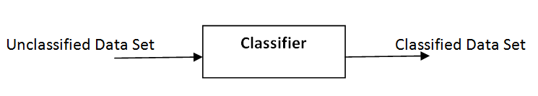
Classification
Classification is a data mining technique used to predict group membership of data instances.
Classification assigns items on a collection to target categories or classes.
The goal of classification is to accurately predict the target class for each case in the data.

Slide 3
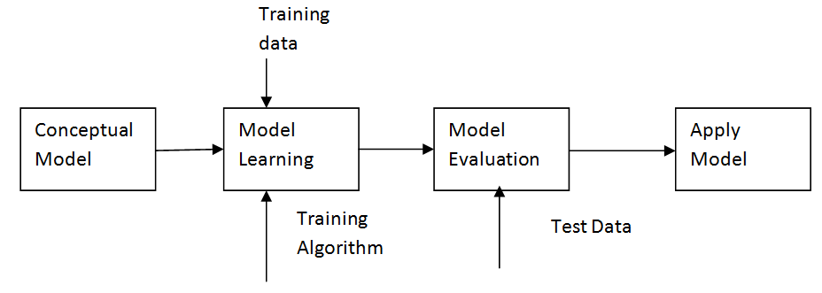
Stages in classification

Slide 4
Classsification Types
Decision Tree classifier
Rule Based Classifier
Nearest Neighbor Classifier
Bayesian Classifier
Artificial Neural Network (ANN) Classifier
Others

Slide 5
1. Decision Tree classifier
A decision tree is tree in which each branch node represents a choice between a number of alternatives and each leaf node represents a classification or decision.
Decision tree is a classifier in the form of a tree structure where a leaf node indicates the class of instances, a decision node specifies some test to be carried out on a single attribute value with one branch and sub-tree for each possible outcome of the test.

Slide 6
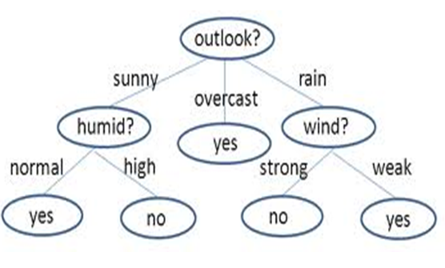
Decision Tree classifier
A decision tree can be used to classify an instance by starting at root of the tree and moving through it until leaf node. The leaf node provides the corresponding class of instance.

Slide 7
Decision Tree Algorithm
Hunt’s Algorithm
ID3, J48, C4.5 (Based on Entropy Calculation)
SLIQ,SPRINT,CART (Based on Gini-Index)

Slide 8
Hunt’s Algorithm
Hunt's algorithm grows a decision tree in a recursive fashion by partitioning the training data into successively into subsets.
Let Dt be the set of training data that reach a node ‘t’. The general recursive procedure is defined as:
If Dt contains records that belong the same class y_{t}, then t is a leaf node labeled as y_{t.}
If Dt is an empty set, then t is a leaf node labeled by the default class, y_{d}
If Dt contains records that belong to more than one class, use an attribute test to split the data into smaller subsets.

Slide 9
Hunt’s Algorithm
It recursively applies the procedure to each subset until all the records in the subset belong to the same class.
The Hunt's algorithm assumes that each combination of attribute sets has a unique class label during the procedure.
If all the records associated with Dt have identical attribute values except for the class label, then it is not possible to split these records any future. In this case, the node is declared a leaf node with the same class label as the majority class of training records associated with this node.

Slide 10
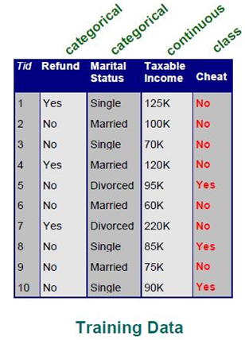
Example

Slide 11
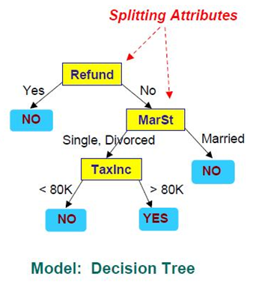
Example

Slide 12

Gini-Index
The Gini Index measures the impurity of data set (D) as:
Gini(D) = 1 -
Where,
n = Number of classes, Pi= Probability of i^{th} class.
It consider binary split for each attribute.
When D is partition into D₁ and D₂ then
Gini(D) = D₁/D Gini(D₁) + D₂/D Gini(D₂)
The attribute that maximize the reduction in impurity is selected as splitting attribute.

Slide 13
ID3 Algorithm
The ID3 algorithm begins with the original dataset as the root node.
On each iteration of the algorithm, it iterates through every unused attribute of the dataset and calculates the entropy (or information gain ) of that attribute.
It then selects the attribute which has the smallest entropy (or largest information gain) value.
The dataset is then split by the selected attribute to produce subsets of the data.

Slide 14
ID3 Algorithm
The algorithm continues to recur on each subset, considering only attributes never selected before. Recursion on a subset may stop in one of these cases:
Every element in the subset belongs to the same class , then the node is turned into a leaf and labeled with the class of the examples
If the examples do not belong to the same class ,
Calculate entropy and hence information gain to select the best node to split data.
Partition the data into subset.
Recursively repeat until all data are correctly classified

Slide 15
ID3 Algorithm
Throughout the algorithm, the decision tree is constructed with each non-terminal node representing the selected attribute on which the data was split, and terminal nodes representing the class label of the final subset of this branch.

Slide 16

Entropy
Entropy H(S) is a measure of the amount of uncertainty in the dataset (S) (i.e. entropy characterizes the dataset (S)).
Where,
S The current dataset for which entropy is being calculated (changes every iteration of the ID3 algorithm)
X - Set of classes
P(x) - The probability of each set S
When H(S) = 0, the set S is perfectly classified (i.e. all elements in S are of the same class).
In ID3, entropy is calculated for each remaining attribute. The attribute with the smallest entropy is used to split the set S on this iteration.
The lower the entropy, the higher the potential to improve the classification here.

Slide 17
Tree Pruning
Tree Pruning is performed in order to remove anomalies in training data due to noise or outliers.
The pruned trees are smaller and less complex.
Pruning is a technique in machine learning that reduces the size of decision trees by removing sections of the tree that provide little power to classify instances.
The dual goal of pruning is reduced complexity of the final classifier as well as better predictive accuracy by the reduction of overfitting and removal of sections of a classifier that may be based on noisy or erroneous data.

Slide 18
Tree Pruning
One of the questions that arise in a decision tree algorithm is the optimal size of the final tree.
A tree that is too large risks overfitting the training data and poorly generalizing to new samples.
A small tree might not capture important structural information about the sample space.
It is hard to tell when a tree algorithm should stop because it is impossible to tell if the addition of a single extra node will dramatically decrease error.

Slide 19
Tree Pruning
A common strategy is to grow the tree until each node contains a small number of instances then use pruning to remove nodes that do not provide additional information.
Pruning should reduce the size of a learning tree without reducing predictive accuracy as measured by a test set or using cross-validation.
There are many techniques for tree pruning that differ in the measurement that is used to optimize performance.

Slide 20
Tree pruning approaches
Prepruning - The tree is pruned by halting its construction early.
Postpruning - This approach removes subtree form fully grown tree.

Slide 21
Pre-pruning
Based on statistical significance test.
Stop growing the tree when there is no statistically significant association between any attribute and the class at a particular node
Most popular test: chi-squared test
ID3 used chi-squared test in addition to information gain.
Only statistically significant attributes were allowed to be selected by information gain procedure.
Pre-pruning may stop the growth process prematurely: early stopping
Pre-pruning faster than post-pruning

Slide 22
Post-pruning
First, build full tree then, prune it.
Fully-grown tree shows all attribute interactions
Problem: some subtrees might be due to chance effects
Two pruning operations:
Subtree replacement
Subtree raising
Possible strategies:
error estimation
significance testing
MDL principle

Slide 23
Advantages of Decision Tree Classifier
Inexpensive to construct
Extremely fast at classifying unknown records
Easy to interpret for small-sized trees
Accuracy is comparable to other classification techniques for many simple data sets

Slide 24
2. Rule-Based Classifier
It classifies records by using a collection of “If ……. Then…..” rules. A rule base classifier uses a set of “If ……. Then…..” rules for classification.
eg: If age = youth AND student = yes THEN buys_computer = yes.
The ‘If’ part or left hand side of a rule is known as the rule antecedent or precondition where as the ‘Then” part or right hand side is the rule consequent.
In the rule antecedent, the condition consists of one or more attribute tests.
If the condition in a rule antecedent holds true for a given tuple, the rule antecedent is satisfied and that the rule covers the tuple.

Slide 25
Rule-Based Classifier
Coverage of a rule is the fraction of records that satisfy the antecedent of a rule.
Coverage = N_{covers} / D
Where,
N_{covers} = number of record that can be classified by the rule.
D = total data set.
Accuracy of a rule is fraction of records that satisfy both the antecedent and consequent of a rule.
Accuracy = N_{correct} / N_{covers}
Where,
N_{correct} = Number of records that are correctly classified by the rule
N_{covers} = Number of record that can be classified by the rule

Slide 26
How does Rule-Based Classifier work?
If a rule is satisfied by a tuple, the rule is said to be triggered. Triggering doesn’t always mean firing because there may be more than one rules that can be satisfied.
Three different cases occur for classification.
Case-I: If only one rule is satisfied
When any instances is covered by only one rule then the rule fires by returning the class prediction for the tuple defined by the rule.

Slide 27
How does Rule-Based Classifier work?
Case-II: If more than one rules are satisfied
If more than one rules are triggered, we need a conflict resolution strategy to find which rule is fired.
Rule ordering or rule ranking or rule priority can be set in case of rules conflict. A rule ordering may be class-based or rule-based.
Rule-based ordering: Individual rules are ranked based on their quality.
Class-based ordering: Rules that belong to the same class appear together
When rule-based ordering is used, the rule set is known as a decision list.
Case-III: If no rule is satisfied
If any instance not triggered by any rule, use default class for classification. Mostly most frequent class is assigned as default class.

Slide 28
Example
Rule base
R1: (Give Birth = No) ^ (Can fly = Yes) => Birds
R2: (Give Birth = No) ^ (Live in Water = Yes) => Fishes
R3: (Give Birth = Yes) ^ (Blood Type = Warm) => Mammals
R4: (Give Birth = No) ^ (Can fly = No) => Reptiles
R5: (Live in Water = Sometimes) => Amphibians
S.No. | Name | Blood Type | Give Birth | Can fly | Live in water | Class
1 | Lemur | Warm | Yes | No | No | ?
2 | Turtle | Cold | No | No | Sometimes | ?
3 | Shark | Cold | Yes | No | Yes | ?

Slide 29
Example
In above example, R1 and R2 don’t have any coverage. R3, R4 & R5 have coverage.
Instance 1 is triggered by R3, instance 2 is triggered by R4 & R5 and instance 3 is not triggered by any instances.
Since instance 1 is triggered by only one rule (R3) so it is fired as a class mammal, instance 2 is triggered by more than two rules (R4 & R5) and hence conflict occurs. To resolve the conflict the class can be identified using priority (rule priority or class priority). Instance 3 is not triggered by any rules, to resolve this conflict default class can be used.

Slide 30
Characteristics of Rule-Based Classifier
Mutually exclusive Rules
Classifier contains mutually exclusive rules if all the rules are independent of each other.
Every record is covered by at most one rule.
Rules are no longer mutually exclusive if a record may triggered by more than one rule. To make mutually exclusive we apply rule ordering.
Exhaustive Rules
Classifier has exhaustive coverage if it accounts for every possible combination of attribute values (every possible rule).
Each record is covered by at least one rule.
Rules are no longer exhaustive if a record may bit trigger any rules. To make rules exhaustive use default class.

Slide 31
Building Classification Rules
Direct Method
Indirect Method:

Slide 32
Direct Method
Extract rules directly from data. It is an inductive and sequential approach.
Sequential Covering
Start from an empty rule
Grow a rule using the Learn-One-Rule function
Remove training records covered by the rule
Repeat Step (2) and (3) until stopping criterion is met
Aspects of Sequential Covering
Rule Growing
Instance Elimination
Rule Evaluation
Stopping Criterion
Rule Pruning

Slide 33
Indirect Method
Extract rules from other classification models (e.g. decision trees, neural networks, etc).
Refund
Yes
No
Marital Status
Loan
Single
Married
Loan
Tax Inc
<= 80K
>80K
No Loan
Loan

Slide 34
Indirect Method
Rules:
R1: (Refund = Yes) => Loan
R2: (Refund = No) ^ (Marital Status = Married) => Loan
Rule simplification
Complex rules can be simplified. In above example R2 can be simplified as:
r2: (Marital Status = Married) => Loan

Slide 35
Advantages of Rule-Based Classifiers
As highly expressive as decision trees
Easy to interpret
Easy to generate
Can classify new instances rapidly
Performance comparable to decision trees

Slide 36
3. Instance Based Classifier
It Store the training records and use training records to predict the class label of unseen cases.
Examples:
Rote-learner
Memorizes entire training data and performs classification only if attributes of record match one of the training examples exactly
Nearest neighbor

Slide 37
Nearest neighbor
Uses k “closest” points (nearest neighbors) for performing classification. K-closet neighbor of a record ‘X’ are data points that have the K-smallest distance of ‘X’.
Classification based on learning by analogy i.e. by comparing a given test tuple with training tuple that are similar to it.
Training tuples are described by n-attributes.
When given an unknown tuple, a k-nearest- neighbor classifier searches the pattern space for the k-training tuples that are closest to the unknown tuple.

Slide 38
Nearest neighbor
Nearest neighbor classifier requires:
Set of stored records
Distance matric to compute distance between records. For distance calculation any standard approach can be used sch as Euclidean distance.
The value of ‘K’, the number of nearest neighbor to retrieve.
To classify the unknown records
Compute distance to other training records.
Identify the k-nearest neighbor.
Use class label nearest neighbors to determine the class label of unknown record. In case of conflict, use majority vote for classification.

Slide 39
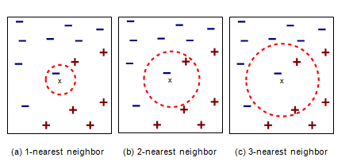
Issues of classification using k-nearest neighbor classification
Choosing the value of K
One of challenge in classification is to choose the appropriate value of K. If K is too small, it is sensitive to noise points. If K is too large, neighbor may include points from other classes.
With the change of value of K, the classification result may vary.

Slide 40
Issues of classification using k-nearest neighbor classification
Scaling Issue
Attribute may have to be scaled to prevent distance measure from being dominated by one of attributes. Eg. Height, Temperature etc.
Distance computing for non-numeric data.
Use Distance as 0 for the same data and maximum possible distance for different data.
Missing values
Use maximum possible distance

Slide 41
Disadvantages:
Poor accuracy when data have noise and irrelevant attributes.
Slow when classifying test tuples.
Classifying unknown records are relatively expensive.

Slide 42
4. Bayesian Classifier
Bayesian classification is based on Baye's Theorem.
It is a statistical classifier that predicts class membership probabilities such as the probability that a given tuple belongs to a particular class.
Baye’s Law
P(A/B) = P(B/A) P(A)/ P(B)
Has high accuracy and speed for large databases.
Has minimum error rate in comparison to all other classifier

Slide 43
Types
Bayesian Belief Networks (Graphical Method)
Naïve Bayesian Classifier

Slide 44
Bayesian Belief Networks
Bayesian Belief Network specifies joint conditional probability distributions.
Bayesian Networks and Probabilistic Network are known as belief network.
It allows class conditional independencies to be defined between subsets of variables.
It provides a graphical model of causal relationship on which learning can be performed.
It represents a set of random variables and their conditional dependencies via a directed acyclic graph

Slide 45
Naive Bayesian Classifier
The Naive Bayes Classifier technique is based on the so-called Bayesian theorem and is particularly suited when the dimensionality of the inputs is high.
It simplifies the computational complexity.
Naïve Bayesian Classifier assumes that the effect of an attribute value on a given class is independent of the value of other attributes i.e. class conditional independence.

Slide 46
Naive Bayesian Classifier
Let D be a training set of tuples and C1, C2, …….., Cm are their associated classes.
Given a tuple X, the classifier will predict that X belongs to the class having highest posterior probability conditioned on X i.e. the Naïve Bayesian classifier predicts that tuple x belong to the class Ci if and only if
P(Ci/X) > P(Cj/X) for 1 j m, j i
i.e. P(Ci/X) = P(X/Ci)P(Ci)/ P(X) maximum
P(X) = Constant
P(Ci) => P(C1) = P(C2) = ………. = P(Cm)
So we need to maximize P(X/Ci)
Naïve assumption is class condition independence,
P(X/Ci) =
= P(x1/Ci) * P (x2/Ci) * …………. * P(xn/Ci)
These probabilities can be calculated from training tuples.

Slide 47
5. Artificial Neural Network (ANN) Classifier
It is set of connected i/o units in which each connection has a weight associated with it.
During the learning phase the network learns by adjusting the weights so as to be able to predict the correct class label of i/p labels.
It also referred as connectionist learning due to connection between units.
It has long training time and poor interpretability but has tolerance to noisy data.
It can classify pattern on which they have not been trained.
Well suited for continuous valued i/ps.
It has parallel topology and processing.

Slide 48
Artificial Neural Network (ANN) Classifier
Before training the network topology must be designed by:
Specifying number of i/p nodes/units: Depends upon number of independent variable in data set.
Number of hidden layers: Generally only layer is considered in most of the problem. Two layers can be designed for complex problem. Number of nodes in the hidden layer can be adjusted iteratively.
Number of output nodes/units: Depends upon number of class labels of the data set.
Learning rate: Can be adjusted iteratively.
Learning algorithm: Any appropriate learning algorithm can be selected during training phase.
Bias value: Can be adjusted iteratively.

Slide 49
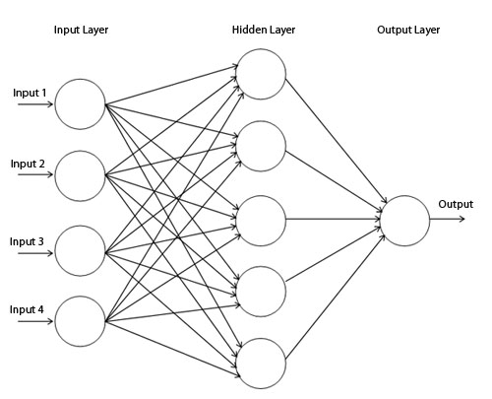
Artificial Neural Network (ANN) Classifier

Slide 50
Back propagation algorithm
Step 1: Initialization:
Set all the weights and thresholds levels of the network to random numbers uniformly distributed inside a small range.
Step 2: Activation:
Activate the back propagation neural network by applying i/ps and desired o/ps.
Calculate the actual o/ps of the neurons in the hidden layers.
Calculate the actual o/ps of the neurons in the o/p layers.

Slide 51
Back propagation algorithm
Step 3: Weight training:
Updates weights in the back propagation network by propagating backwards the errors associated with the o/p neurons.
Calculate error gradient of o/p layer and hence of neurons in the hidden layer.
Step 4: Iteration:
Increase iteration by repeating steps 2 and 3 until selected error criteria is satisfied.

Slide 52
Issues:
Overfitting
Validation
Model Comparison

Slide 53
Overfitting
Overfitting occurs when a statistical model describes random error or noise instead of the underlying relationship.
Overfitting generally occurs when a model is excessively complex, such as having too many parameters relative to the number of observations.
A model which has been overfit will generally have poor predictive performance.
Overfitting depends not only on the number of parameters and data but also the conformability of the model structure.

Slide 54
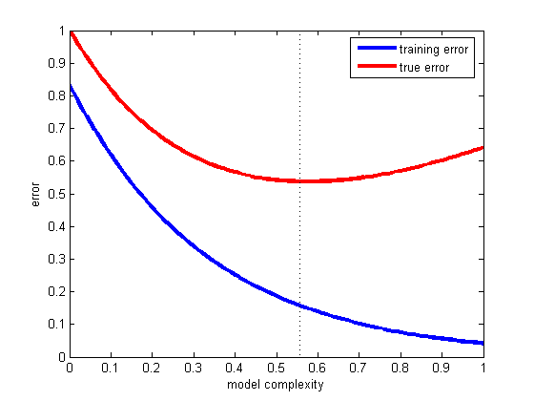
Overfitting
In order to avoid overfitting, it is necessary to use additional techniques (e.g. cross-validation, pruning (Pre or Post), model comparison

Slide 55
Overfitting
Reason
Noise in training data.
Incomplete training data.
Flaw in assumed theory.

Slide 56
Validation
Validation techniques are motivated by two fundamental problems in pattern recognition: model selection and performance estimation
Validation Approaches:
One approach is to use the entire training data to select our classifier and estimate the error rate, but the final model will normally overfit the training data.
A much better approach is to split the training data into disjoint subsets cross validation ( The Holdout Method)

Slide 57
Cross Validation (The holdout method)
Data set divided into two groups.
Training set: used to train the classifier and
Test set: used to estimate the error rate of the trained classifier
Total number of examples = Training Set +Test Set
Approach:
Random Sub sampling
Random Sub sampling performs K data splits of the dataset
Each split randomly selects (fixed) no. examples without replacement
For each data split we retrain the classifier from scratch with the training examples and estimate error with the test examples

Slide 58
K-Fold Cross-Validation
K-Fold Cross validation is similar to Random Sub sampling.
Create a K-fold partition of the dataset, For each of K experiments, use K-1 folds for training and the remaining one for testing.
The advantage of K-Fold Cross validation is that all the examples in the dataset are eventually used for both training and testing.
The true error is estimated as the average error rate

Slide 59
Model Comparison:
Models can be evaluated based on the output using different method :
Confusion Matrix
ROC Analysis
Others such as: Gain and Lift Charts, K-S Charts

Slide 60
Confusion Matrix (Contigency Table):
A confusion matrix contains information about actual and predicted classifications done by classifier.
Performance of such system is commonly evaluated using data in the matrix.
It is also known as a contingency table or an error matrix, is a specific table layout that allows visualization of the performance of an algorithm.
Each column of the matrix represents the instances in a predicted class, while each row represents the instances in an actual class.

Slide 61
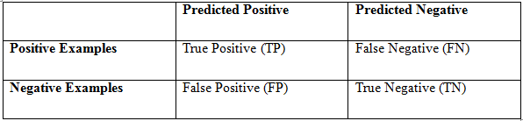
Confusion Matrix
Accuracy: (TP + TN) / Total data count
Precision: TP / (TP + FP) or TN/ (TN + FN)
True Positive Rate (TPR): TP / (TP +TN)
True Negative Rate (TNR): TN / (TP +TN)
False Positive Rate (FPR): FP / (FP +FN)
False Negative Rate (FNR): FN / (FP +FN)

Slide 62
ROC Analysis
Receiver Operating Characteristic (ROC), or ROC curve, is a graphical plot that illustrates the performance of a binary classifier system as its discrimination threshold is varied.
The curve is created by plotting the true positive rate against the false positive rate at various threshold settings.
The ROC curve is thus the sensitivity as a function of fall-out.

Slide 63
ROC Analysis
In general, if the probability distributions for both detection and false alarm are known, the ROC curve can be generated by plotting the cumulative distribution function (area under the probability distribution from to ) of the detection probability in the y-axis versus the cumulative distribution function of the false-alarm probability in x-axis.
ROC analysis provides tools to select possibly optimal models and to discard suboptimal ones independently from (and prior to specifying) the cost context or the class distribution.
ROC analysis is related in a direct and natural way to cost/benefit analysis of diagnostic decision making.

